Slide 1
Codecast
A collbaration focused text editor on the web.

Slide 2
Focus
A online text editor.
Focus on developers.

Slide 3
Features
Collaborate in real time.
Version Control System Integration (Git, Mercurial)
Run and write tests your app without leaving the site.
Publishing integration for open source projects (Github, NPM, Bower)

Slide 4
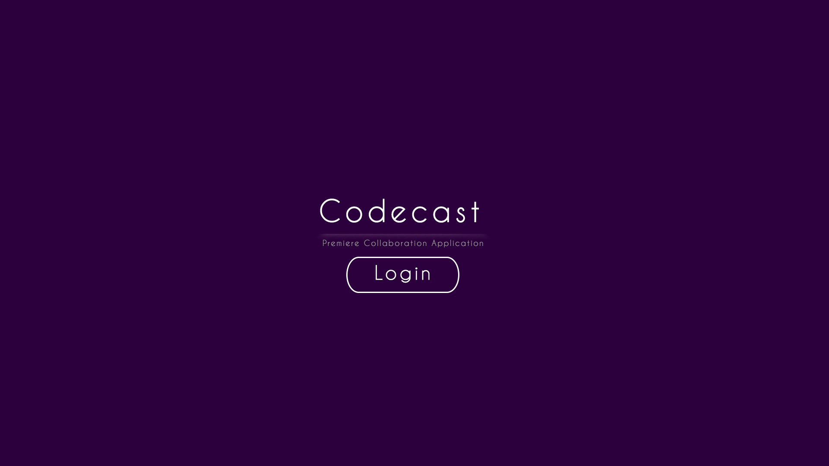
Homepage image

Slide 5
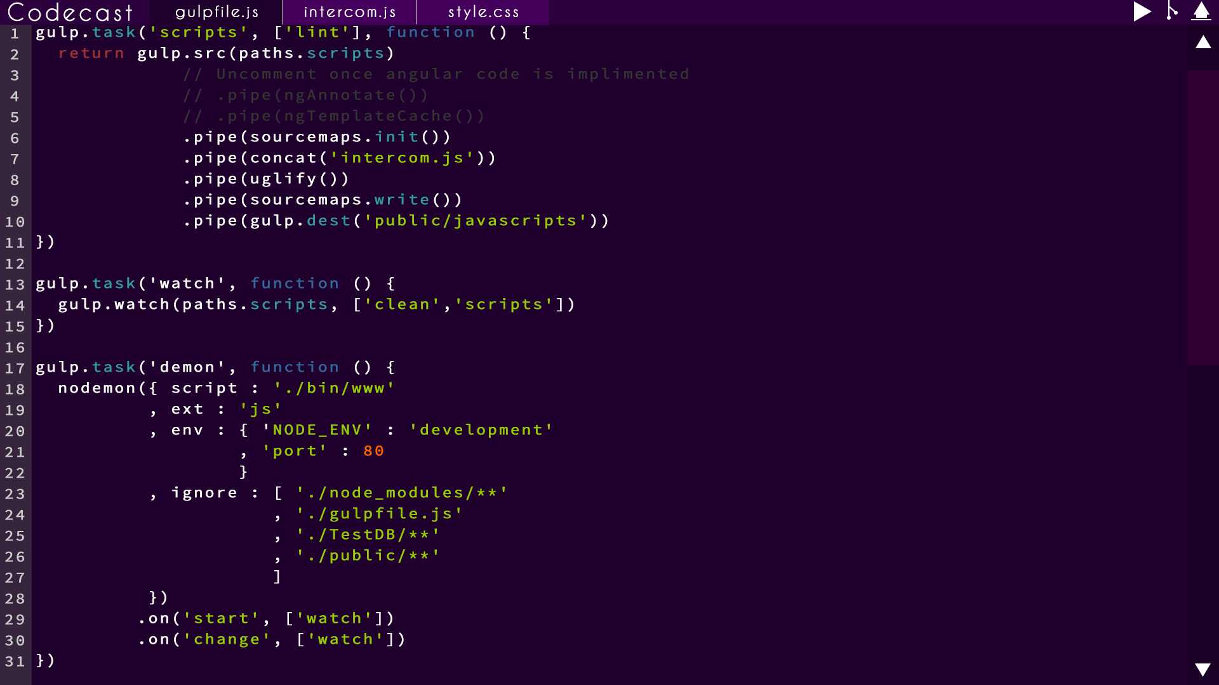

Slide 6
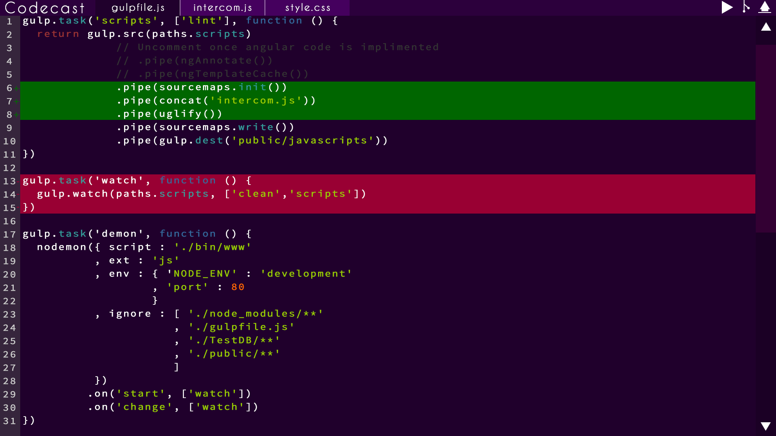
Running the code page

Slide 7
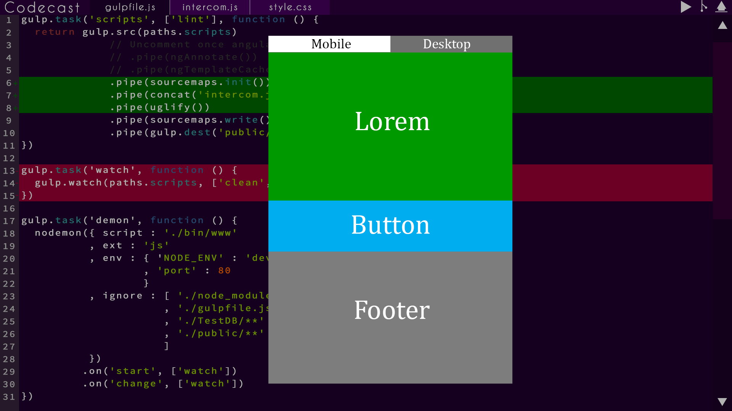

Slide 8
Revenue Generation
All features would be available to use
Limited space and number of people on the team
Monthly subscription options to gain access more space and more collaborators

Slide 9
Examples:
Codepen
- Adds the features proposed for this app, but is behind a $75/year subscription wall.
Github:
- Charges monthly 'plans' for having private repo's for your code.

Slide 10
'Enterprise' Version
We would have for a version designed for big teams who would require a local version and have it totally integrated with their workspace.
We would charge ~$2500 per 25 people (~$100 per person).

Slide 11
'Enterprise' Examples
Github:
- Charges currently $5000 per 20 seats.
NPM
- Still in development, free trial available, pricing unkown

Slide 12
Future after 1.0
Expand to full complete team integration. (Conference calling, scrum scheduling, requirements documents).
Presentational or educational version designed for lectures that involve code.
Expand to compiler required(native) languages

Slide 13
Community Promotion
An API (Application Program Interface) for our editor allowing users to build their own plugins.

